Slide 1

Summary : Intermediate Machine Learning – Unsupervised Learning
by : Dhea Fajriati Anas

Slide 2

01
02
03
INTRO TO CLUSTERING
HIERARCHICAL CLUSTERING
DBSCAN
TABLE OF CONTENTS
04
05
06
HDBSCAN
ISOLATION FOREST
EVALUATION METRICS

Slide 3

01
INTRO TO CLUSTERING

Slide 4
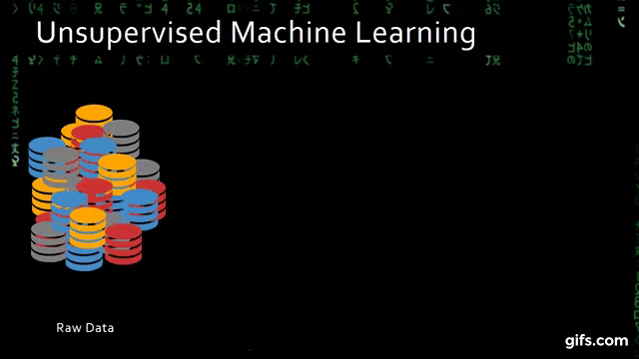
DEFINITION
What is clustering ?
Cluster is the collection of data objects which are similar to one another within the same group (class or category) and are different from the objects in the other clusters. In unsupervised learning our model tries to find “natural” grouping of instances for a given unlabeled data.
Why clustering ?
Clustering allows us to find hidden relationship between the data points in the dataset. Examples :
.In marketing, customers are segmented according to similarities to carry out targeted marketing.
Given a collection of text, we need to organize them, according to the content similarities to create a topic hierarch, and etc
Detecting distinct kinds of pattern in image data (Image processing). It’s effective in biology research for identifying the underlying patterns.

Slide 5

02
HIERARCHICAL CLUSTERING

Slide 6
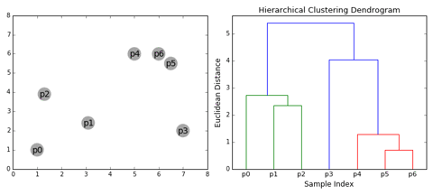
DEFINITION
What is hierarchical clustering?
Hierarchical Clustering is an unsupervised clustering algorithm which involves creating clusters that have predominant ordering from bottom up or top down. The main output of Hierarchical Clustering is a dendrogram, which shows the hierarchical relationship between the clusters:

Slide 7
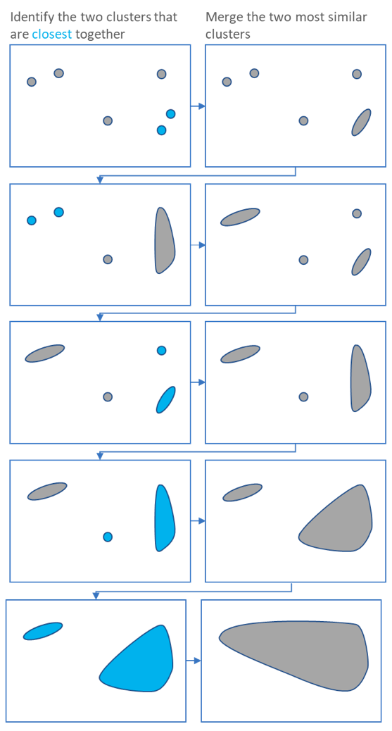
DEFINITION
How hierarchical clustering works ?
Hierarchical clustering starts by treating each observation as a separate cluster. Then, it repeatedly executes the following two steps:
Identify the two clusters that are closest together, and
Merge the two most similar clusters. This iterative process continues until all the clusters are merged together. This is illustrated in the diagrams.

Slide 8
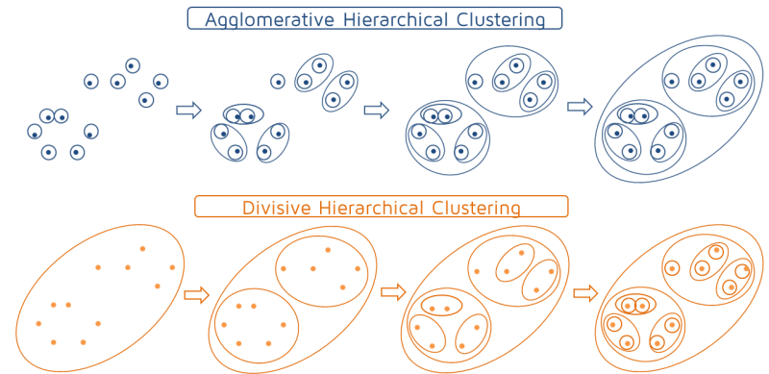
HIERARCHICAL CLUSTERING TECHNIQUES
What is Agglomerative ?
It's a bottom-up approach, each observation starts in its own cluster, and pairs of clusters are merged as one moves up the hierarchy.
What is Divisive or DIANA ?
The divisive algorithm, in turn, starts with every object in one cluster and ends with every object in individual clusters.

Slide 9

03
DBSCAN

Slide 10

DEFINITION
What is DBSCAN (Density Based Spatial Clustering of Applications with Noise)?
Density-Based Spatial Clustering of Applications with Noise (DBSCAN) is a base algorithm for density-based clustering. It can discover clusters of different shapes and sizes from a large amount of data, which is containing noise and outliers.
The DBSCAN algorithm uses two parameters:
minPts : the minimum number of points (a threshold) clustered together for a region to be considered dense.
eps (ε) : a distance measure that will be used to locate the points in the neighborhood of any point.

Slide 11
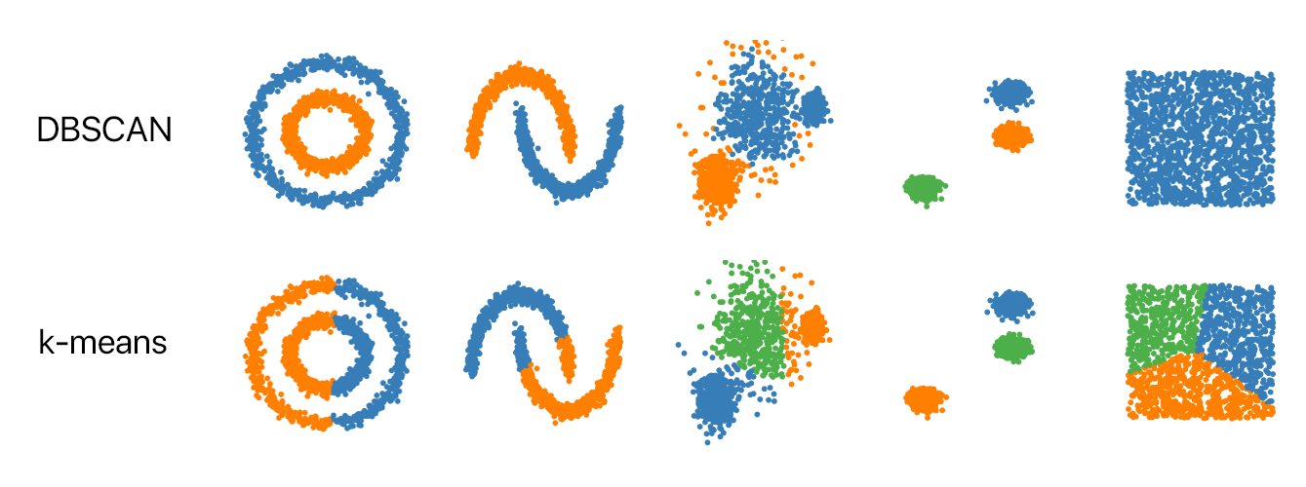
DEFINITION
Why DBSCAN (Density Based Clustering Algorithm)?
What’s nice about DBSCAN is that you don’t have to specify the number of clusters to use it. It can automatically detect the number of clusters based on your input data and parameters.
DBSCAN can handle noise and outliers. All the outliers will be identified and marked without been classified into any cluster. Therefore, DBSCAN can also be used for Anomaly Detection (Outlier Detection).
This algorithm good for non heavy-cluttered dataset.
DBSCAN also produces more reasonable results than k-means across a variety of different distributions. Below figure illustrates the fact:

Slide 12

04
HDBSCAN

Slide 13
DEFINITION
What is HDBSCAN (Hierarchical Density Based Spatial Clustering of Applications with Noise) ?
A combination algorithm of Hierarchical Clustering and DBSCAN. It is claimed as a faster and more reliable algorithm compared to others.
Why HDBSCAN (Hierarchical Density Based Spatial Clustering of Applications with Noise) ?
It can automatically detect the number of clusters
HDBSCAN can handle noise and outliers. All the outliers will be identified and marked without been classified into any cluster
Therefore, HDBSCAN can also be used for Anomaly Detection (Outlier Detection)

Slide 14
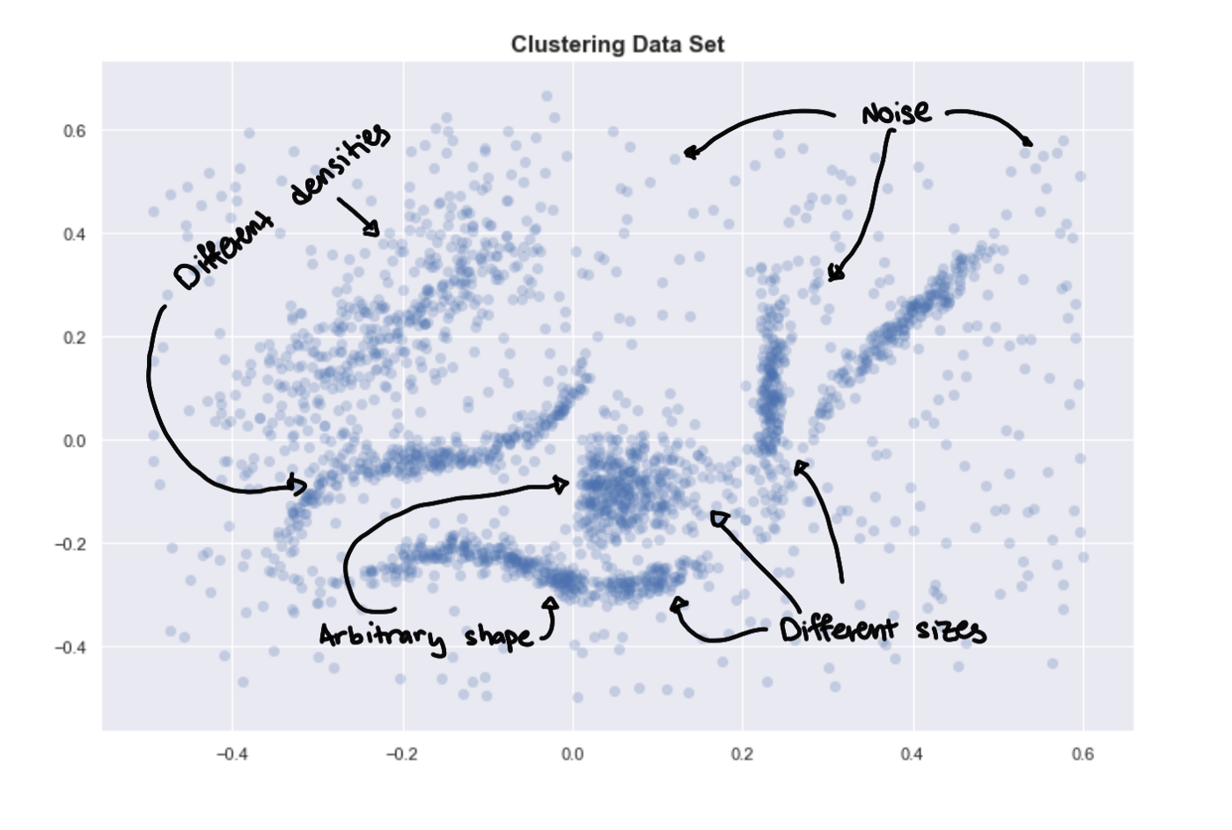
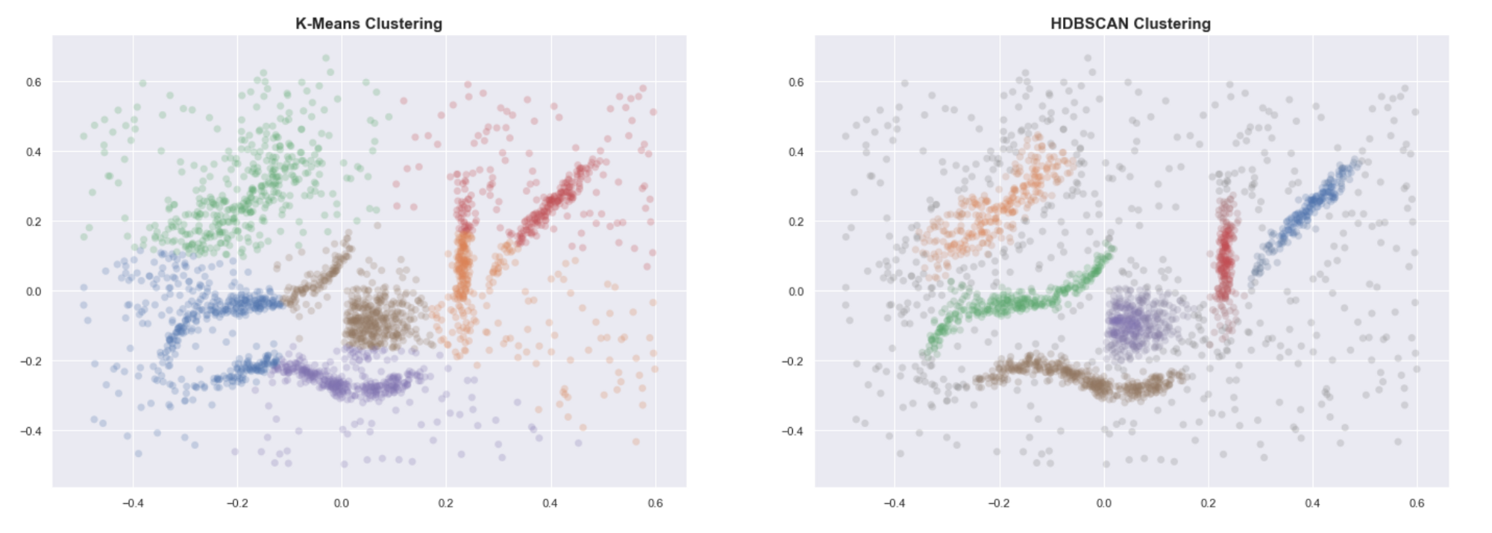
K-MEANS VS HDBSCAN
Even when provided with the correct number of clusters, K-means clearly fails to group the data into useful clusters. HDBSCAN, on the other hand, gives us the expected clustering.
How does HDBSCAN do this? At a high level, we can simplify the process of density-based
clustering into these steps:
Estimate the densities
Pick regions of high density
Combine points in these selected regions
The Characteristic of Data

Slide 15
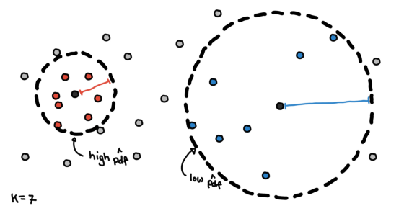
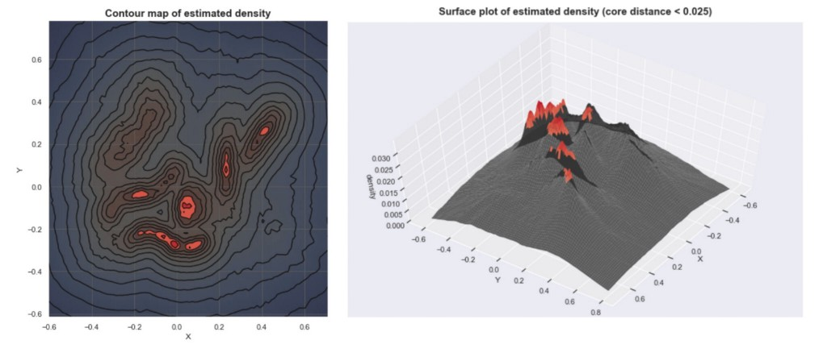
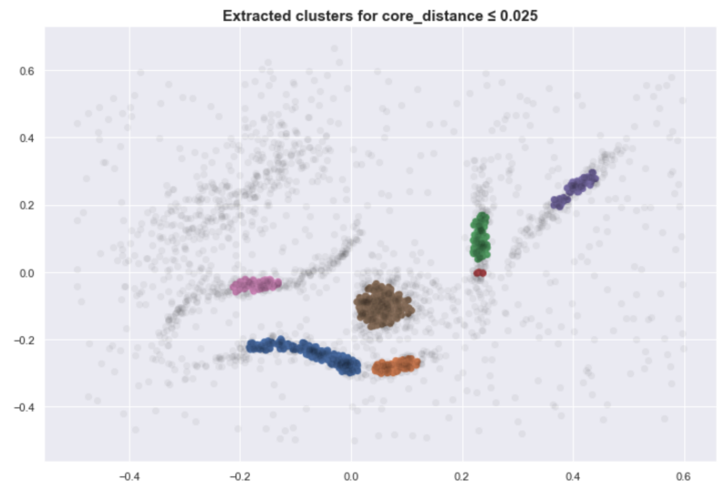
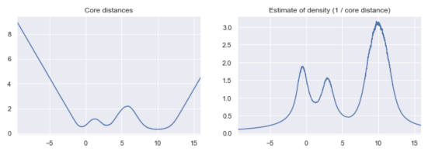
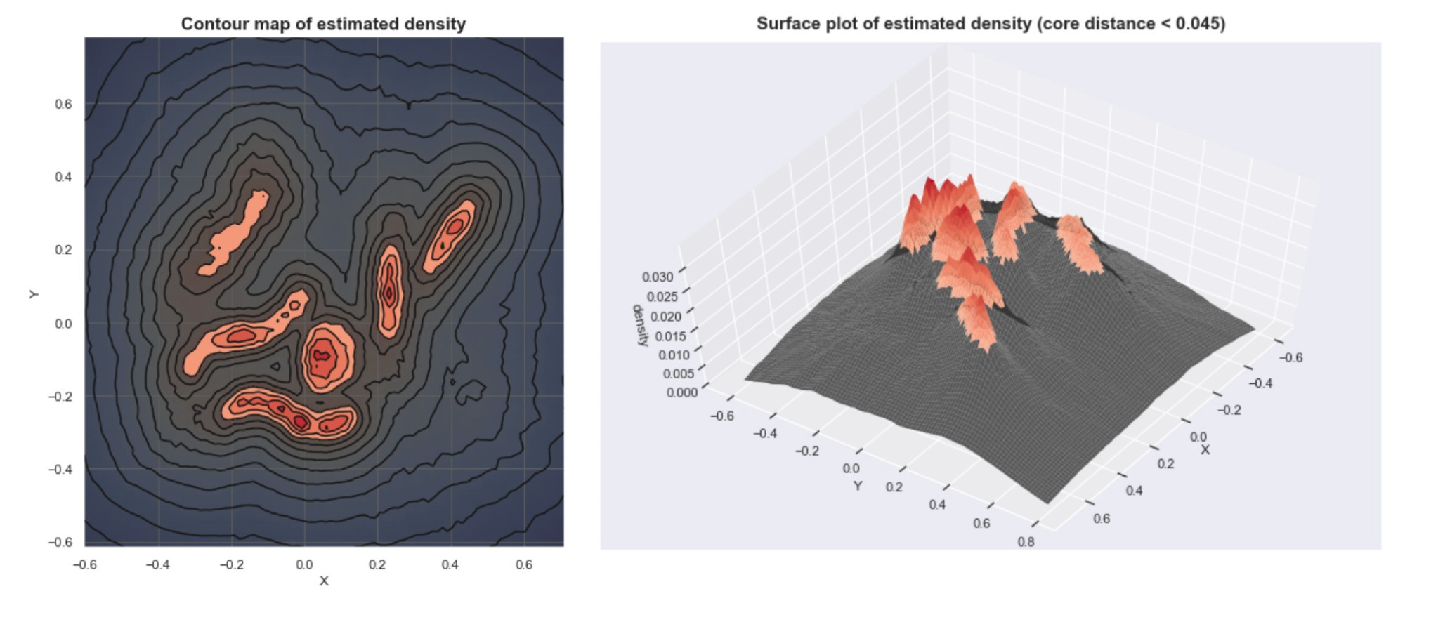
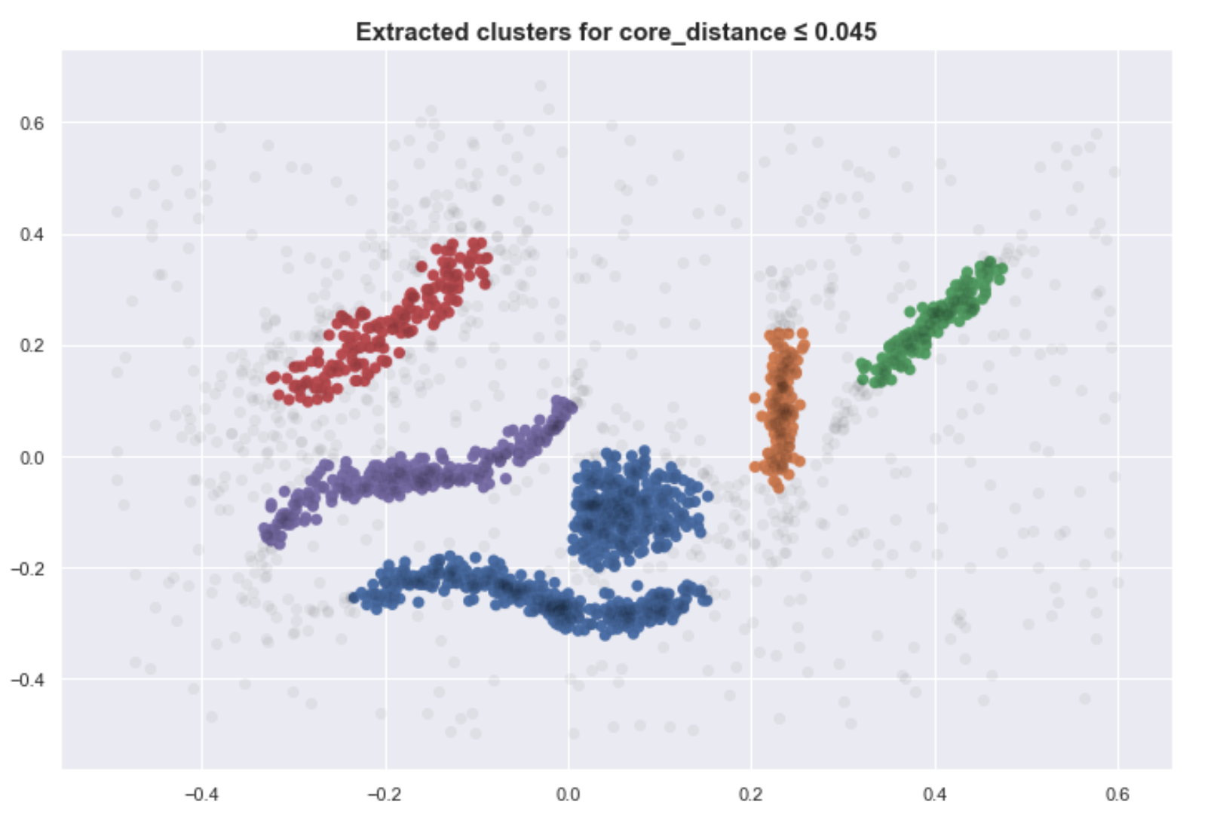
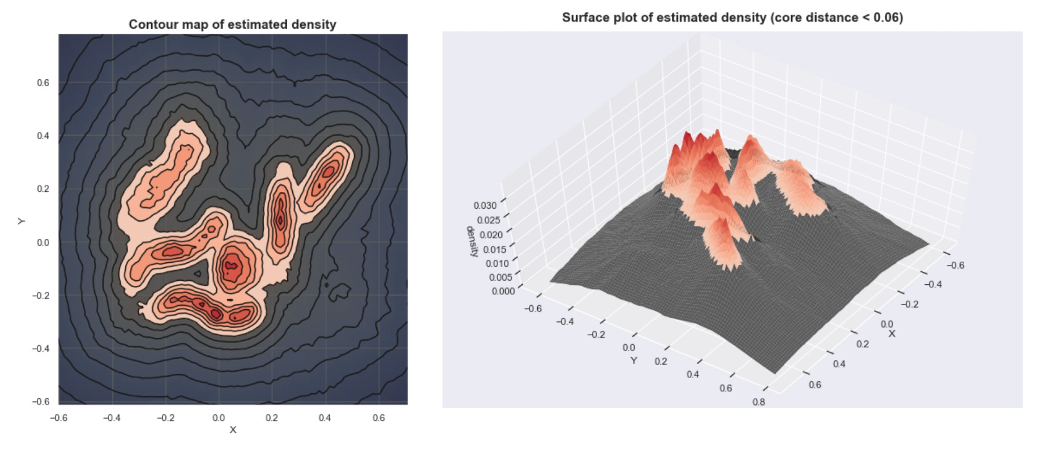
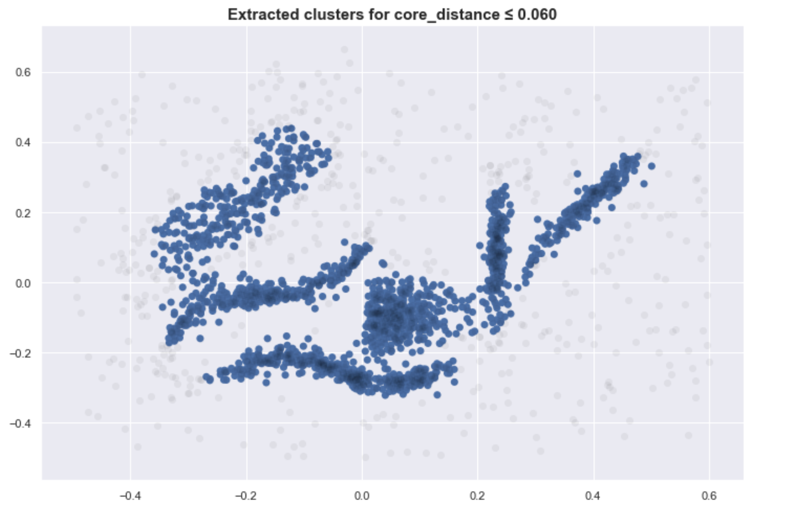
How HDBSCAN works ?
Estimate the densities
We need some method to estimate the density around certain points. One common way to do this is by using “core distance.” This is the distance of a point to its K-th nearest neighbor.
Pick regions of high density
Points in denser regions would have smaller core distances while points in sparser regions would have larger core distances. Core distance is what makes these methods “density-based”.
Combine points in these selected regions
Given the core distances, we can derive an estimate of the density by getting the inverse of it. With these estimates, we can get an idea of what the density landscape looks like. If we plot these densities, we can see that the mountains of this density landscape correspond to the different clusters of the data.

Slide 16

05
ISOLATION FOREST

Slide 17
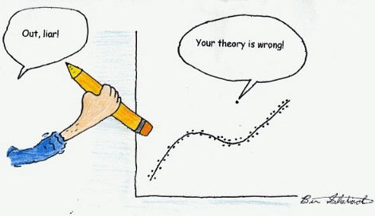
DEFINITION
What is isolation forest ?
“Isolation Forest” is a brilliant algorithm for anomaly detection.
Isolation forest works on the principle of the decision tree algorithm. It isolates the outliers by randomly selecting a feature from the given set of features and then randomly selecting a split value between the maximum and minimum values of the selected feature. This random partitioning of features will produce smaller paths in trees for the anomalous data values and distinguish them from the normal set of the data.

Slide 18
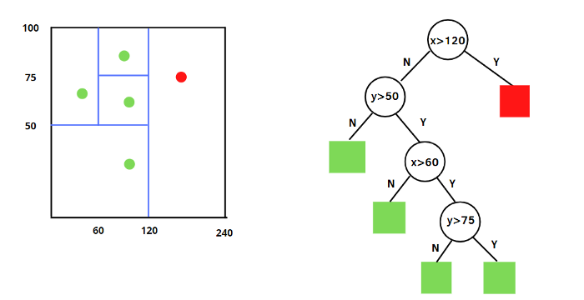
DEFINITION
How isolation forest works ?
Isolation Forest is very similar to Random Forests and is built based on an ensemble of decision trees for a given dataset. However, there are some differences. Isolation Forest identifies anomalies as the observations with short average path lengths on the isolation trees. There is a procedure applied for each isolation tree:
Randomly select two features
Split the data points by randomly selecting a value between the maximum and the minimum of the selected features
The partition of observations is repeated recursively until all the observations are isolated.
Show examples of the procedure after four splits, respectively. In this case, we had only two features x and y and four observations to check.
The first condition is the one that distinguishes a normal observation from an anomaly. If x is bigger than 120, then the observation is an outlier and is coloured in red. Then, normal and anomalous data points can be distinguished based on average path length: shorter paths indicates that we have anomalies, while longer path shows that there are normal observations.

Slide 19
06
EVALUATION METRICS

Slide 20
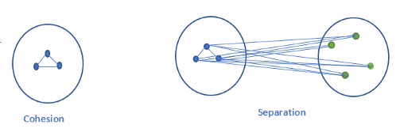
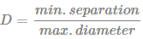
Davis-Bouldin Index (DBI)
Davies-Bouldin Index evaluates intra-cluster/separation similarity and inter-cluster/cohesion differences. Lower the DB index value, better is the clustering. It also has a drawback. A good value reported by this method does not imply the best information retrieval.
Silhoutte Score
Measure the distance between each data point, the centroid of the cluster it was assigned to and the closest centroid belonging to another cluster. Its value ranges from -1 to 1.
1: means clusters are well apart from each other and clearly distinguished.
0: means clusters are indifferent, or we can say that the distance between clusters is not significant.
-1: means clusters are assigned in the wrong way.
Formula :
Silhoutte Score = (b-a)/max(a,b)
where,
a = average intra-cluster distance i.e the average
distance between each point within a cluster
b = average inter-cluster distance i.e the average
distance between all clusters
Dunn Index
Higher the Dunn index value, better is the clustering. The number of clusters that maximizes Dunn index is taken as the optimal number of clusters k. It also has some drawbacks. As the number of clusters and dimensionality of the data increase, the computational cost also increases. Formula :

Slide 21
THANKS !

